Slide 1
Appointment Of Representative GER Solution Architecture
Version 1.1
December 29, 2020
Kirk Rozelle, Principal Architect

Slide 2
Summary of Recent Updates to this Document
Date | Doc Version | Description of Changes
12/29/2020 | 1.1 | Re-baseline with recent changes.
8/28/2020 | 1.0 | Baseline version

Slide 3
Summary of Impacted Product Lines
Product Line | Application | Application Service
Contact Center Solutions | MedAccess Web | Member Details UI
 | MedAccess Web | View AOR Info UI
Data Exchange Solutions | Type 88 AOR File Load | AOR Data Load
 | ID Card Generation Interface | ID Card Generation
Prior Authorization Solutions | CDA/MRSP/Utility Web Services and Sub-Components | CDA Communication WS
 | Document Mgmt (FileNet) Web Service | Document Mgmt WS
 | MedResponse | AOR Management UI
 |  | MedResponse BPM UI
 |  | MedResponse IVR Extract
 | Appeals | Appeals WS
 |  | AOR Management UI (Appeals)
 |  | Process Appeal Angular UI
Workforce Solutions | Employee Portal | AOR Management UI
Contact Center Solutions | MedAccess Web | Member Details UI
 | MedAccess Web | View AOR Info UI
Data Integration Solutions | Data Lake ETL | Appointed Representative ETL
 | EDW ETL | Appointed Representative ETL
 | MEDDM ETL | Appointed Representative ETL
Enterprise Reporting and BI Solutions | MedOptimize | Part D CDAG Reports

Slide 4
Architecture Decision Catalog (1 of 4)
Decision ID | Name | Problem Statement | Decision | Decision Date | Status
1 | System Of Record for AOR data | Though it is not widely used, there is an existing repository for AOR info in the Claims Processing (MEDM/MEDATA) repository. However, should the maser repository for AOR data be located in the Consumer Info repository instead? | The master repository for AOR info will be in the Consumer Info repository. - Empowering consumers to manage their AOR info aligns with MedImpact’s strategic direction to provide services geared towards consumers rather than members that only have PBM benefits serviced by MedImpact. | 6/6/2019 | Approved. Reviewed with Consumer Portal business owners, IT DB Ops, and Enterprise Analytics
2 | De-centralized management of AOR data (business process change decision) | Currently, all Part D AOR requests are routed through the Appeals team for entry into Member Comments via MedAccess. After this GER, will there continue to be a centralized processing of AOR requests or will it be performed elsewhere? | Entry of AOR data will be performed by individuals associated with the various operational business processes that make use of the AOR data (i.e., PA, Appeals, Grievances, DMR, Contact Center). | 5/2/2019 | Approved. Met with the affected teams and all agree on handling AOR in the context of their own process.
3 | No Automation of AOR submitted via fax | Part D members may submit AOR Requests via fax and clients may submit approved AOR/POA Requests (Part D/Commercial) via fax. Is automation needed to store the faxes directly into FileNet from RightFax? | Due to the low number of AOR requests, defer this automation. RightFax users can store a fax as a PDF onto a file share disk and then use an AOR management screen to upload the PDF into FileNet. [Note: Manual upload of a PDF into FileNet will also be used for mailed/scanned forms and emailed docs.] | 4/18/2019 | Approved. Affected teams feel volume is low enough to use a “save and upload” process to store AOR docs in FileNet.

Slide 5
Architecture Decision Catalog (2 of 4)
Decision ID | Name | Problem Statement | Decision | Decision Date | Status
4 | UI for management of AOR Info | Several different business processes served by different applications require MedImpact personnel to enter and modify AOR info associated with a member. Three options for the AOR management user interfaces are considered: Swivel Chair to AOR UI in Employee Portal: All users will use an AOR UI in Employee Portal (i.e., swivel-chair approach) SSO Link to AOR UI in Employee Portal: Applications will contain an SSO link to an AOR UI in Employee Portal which passes in member info to avoid searching for the member again. Native UI in Each Application: Screens to manage AOR will be built into the native UI for each application (PA, Appeals, MedAccess). A common API for management of AOR info will be used by each separate UI. | Recommend “Native UI in Each Application”: “Native UI in Each Application” enables user experience to be tailored to business process. AOR management rules continue to be enforced by all UI’s using the same Consumer Info web service for entry/editing/viewing AOR data. Although “Swivel Chair to AOR UI in Employee Portal” is may be a viable option in the short term while AOR volume is low, it is a burden on users to re-lookup the member in MedAccess. The “SSO Link to AOR UI in Employee Portal” option is a close second to “Native UI in Each Application”. It avoids re-lookup of the member in the swivel-chair approach. However, if the demand for entry of AOR increases, the “Native UI in Each Application” option can provide a more seamless user experience. | 5/29/2019 | Approved. Met with Nishi and Zahid to discuss options and select recommended approach.
5 | AOR info for MedAccess Classic | Even though MedAccess Classic is way overdue for retirement, it is still the primary application used for processing DMRs. What AOR capabilities need to be supported in MedAccess Classic? View indicator if a member has an active Appointed Representative? View details about the Appointed Representative? Create and edit AOR info for a member? | MedAccess Classic will not be used to support any of the AOR capabilities described in the Problem Statement (Create/Update/View AOR). Note: There is existing AOR capabilities in MedAccess Classic that will no longer be valid once this GER is implemented. Thus, MedAccess Classic may need to be modified to disable/hide the existing AOR-related capabilities. |  | Approved. Tim Fisher (Sup. Claim Processing for DMRs) agreed to DMR team can use MedAccess for viewing AOR info rather than MedAccess Classic. Cate Osterrieder (Lead Client Services) agreed that AOR UI in Employee Portal will work for them … with training.

Slide 6
Architecture Decision Catalog (3 of 4)
Decision ID | Name | Problem Statement | Decision | Decision Date | Status
6 | Storage of Appointed Representative in the Data Model | In the Data Model for storing the AOR-related data, two options were considered regarding what table to store the info representing the Appointed Representative. Create a new “Appointed Representative” table to store the appointed representative info. The record for an appointed representative will be associated with a PBM Member record via the new “AOR” table. There was concern expressed with this approach that if a consumer is also an appointed representative, then their demographic info will be stored in both the Consumer record and the Appointed Representative record. Store the info for an appointed representative in a record in the “Consumer” table. Concern was expressed that logic for identifying whether this consumer is acting as an appointed representative or as a regular consumer will proliferate throughout applications. Also, there was a concern that the standards for vetting info entered for an appointed representative may be much more informal than establishing a record for a normal “Consumer”. The mixing of info in the one “Consumer” table for multiple types of users (true consumers and appointed representatives) will likely lead to considerable management complexity and increased possibility of mixing up the authorizations normally granted to one or the other. | Approach 1, a separate “Appointed Representative” table to store info for the appointed representative, is the recommended approach. This will meet all the near-term AOR goals that spawned the need for the AOR GER and it should be able to support/grow to support future Consumer Portal needs. | 7/18/2019 | Approved

Slide 7
Architecture Decision Catalog (4 of 4)
Decision ID | Name | Problem Statement | Decision | Decision Date | Status
7 | AOR Type 88 File Load | Three candidate architectures were considered for the AOR Type 88 File Load solution. Informatica + CIM Web Service: Informatica for file handling, reading each record, calling CIM web service to load record into database, and write status to log files. Batch Type 88 application using logic in CIM code library (built by Consumer Solutions team). Batch Type 88 file load logic completely implemented in Informatica (built by Data Exchange team). | Option 1 will be used. This follows the architectural pattern already employed for the Type 42 and Type 46(?) file load solutions. Pros: Consumer Solutions team owns & manages single source of truth for code that creates the AOR records and the base records associated with a Consumer (CONSUMER , CONSUMER_MBR, CACCOUNT , CONSUMER_ADDR , and CONSUMER_PHONE records) Data Exchange team employs standard file handling conventions (file intake, archiving, log file and error file generation) Cons: One web service call per AOR record is inefficient. (However, expected number of Type 88 files/records expected to be fairly low volume and not over-tax use of the web service.) | 3/31/2020 | Approved

Slide 8
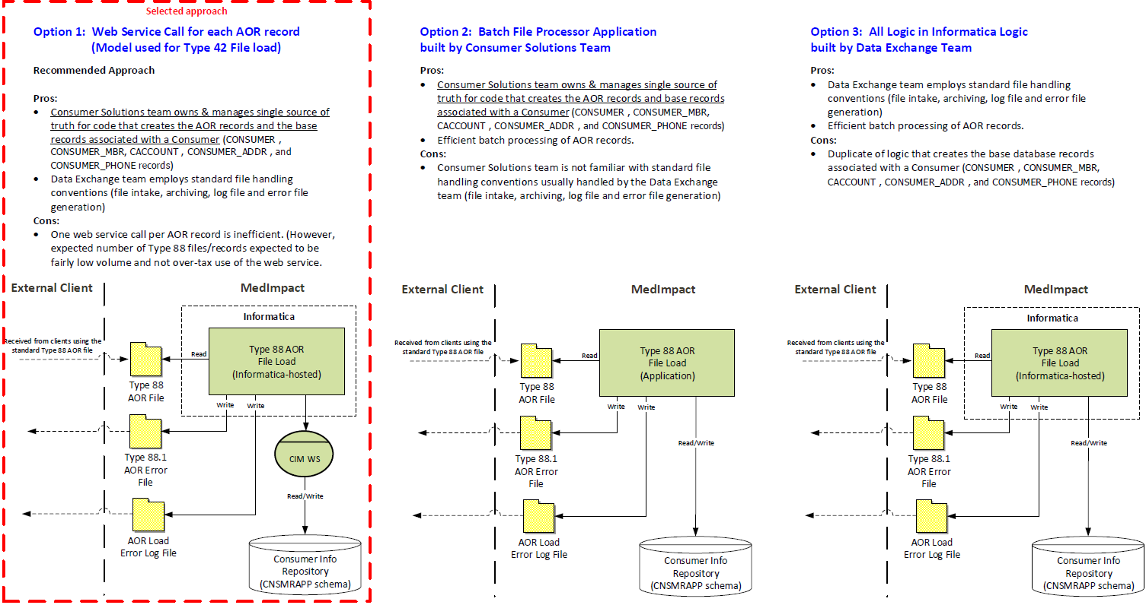
AOR Type 88 File Load Architecture Options

Slide 9
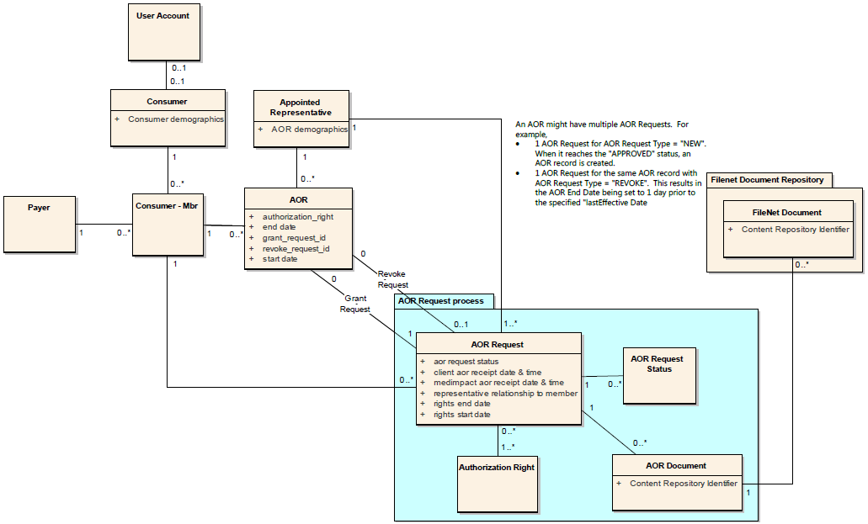
Domain Model

Slide 10
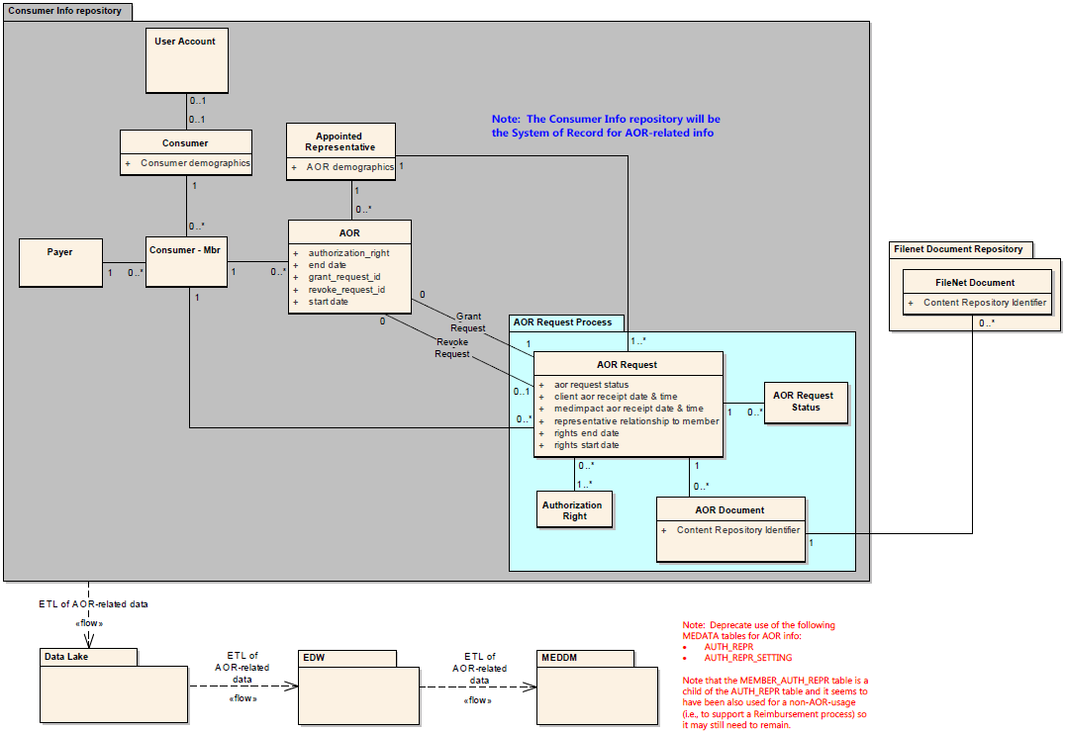
Target Architecture – Data Landscape

Slide 11
AOR Authorization Rights
Authorization Rights Types
PERSONAL_REPRESENTATIVE = Appointed Representative is able to participate in PBM operations on behalf of the member.
Includes: Contact Center conversations and submitting DMR, PA, and Appeal requests on behalf of the member.
Excludes: Rights that are only granted via the CONSUMER_PORTAL_ACESS authorization rights.
CONSUMER_PORTAL_ACCESS = Appointed Representative is able to access the Consumer Portal to view and perform actions on behalf of the member (viewing benefits and claims, placing Mail Orders, etc.)
Number of AOR Authorized Representatives per Member
Part D: The guidance from CMS states that when an enrollee has more than one appointed representative on file, the plan should honor the most recently submitted Appointment of Representative Form or equivalent written notice when deciding which person to treat as the enrollee’s appointed representative.
At present, there are no plans for MedAccess to restrict users from viewing all active AORs for a member. Thus, Contact Center training will be needed to enforce this restriction (or changes will be needed to MedAccess).
PA and Appeals “Member Letters”: MedResponse and Appeals applications currently only support sending a single PA/Appeal “Member Letter”. Thus, if an active AOR exists for a member with authorization right = “PERSONAL_REPRESENTATIVE”, the PA/Appeal “Member Letter” will be sent to the most-recently submitted AOR (if any).
Member ID Cards: The Member ID Card Generation application (cards.sqr) currently only supports sending a single Member ID Card. Thus, if an active AOR exists for a member, the Member ID Card will be sent to the most-recently submitted AOR with authorization right = “PERSONAL_REPRESENTATIVE” (if any).
Consumer Portal Access: The Consumer Portal supports a member to have multiple active users with the “CONSUMER_PORTAL_ACCESS” authorization right to view/perform Consumer Portal actions on behalf of a member.

Slide 12
Target Application Landscape Overview
Target Application Landscape is depicted in 4 diagrams
AOR Management
AOR Assistance (UIs for AOR Management)
AOR Consumers
AOR Reporting
Service-level Application Impacts
Application Interface Service Specification
Batch Service Specification
User Interface Service Specification

Slide 13
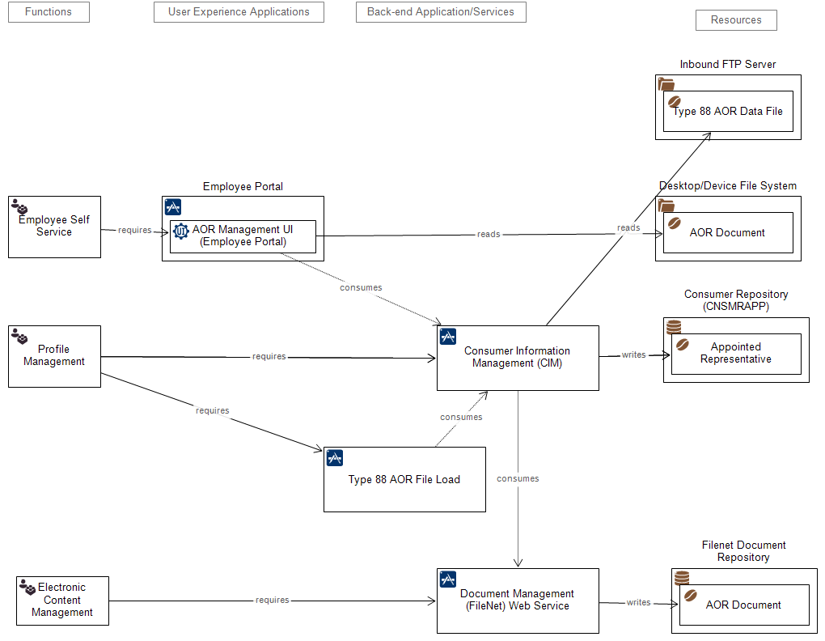
Target Architecture Landscape – AOR Management

Slide 14
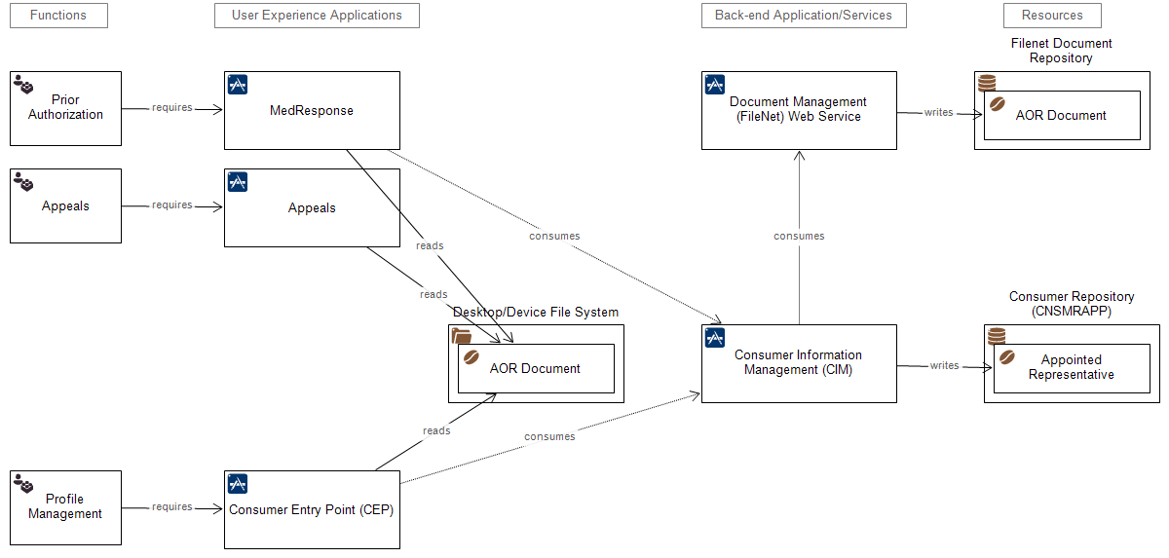
Target Architecture Landscape – AOR Assistance (i.e., UIs to manage AOR as part of other processes)

Slide 15
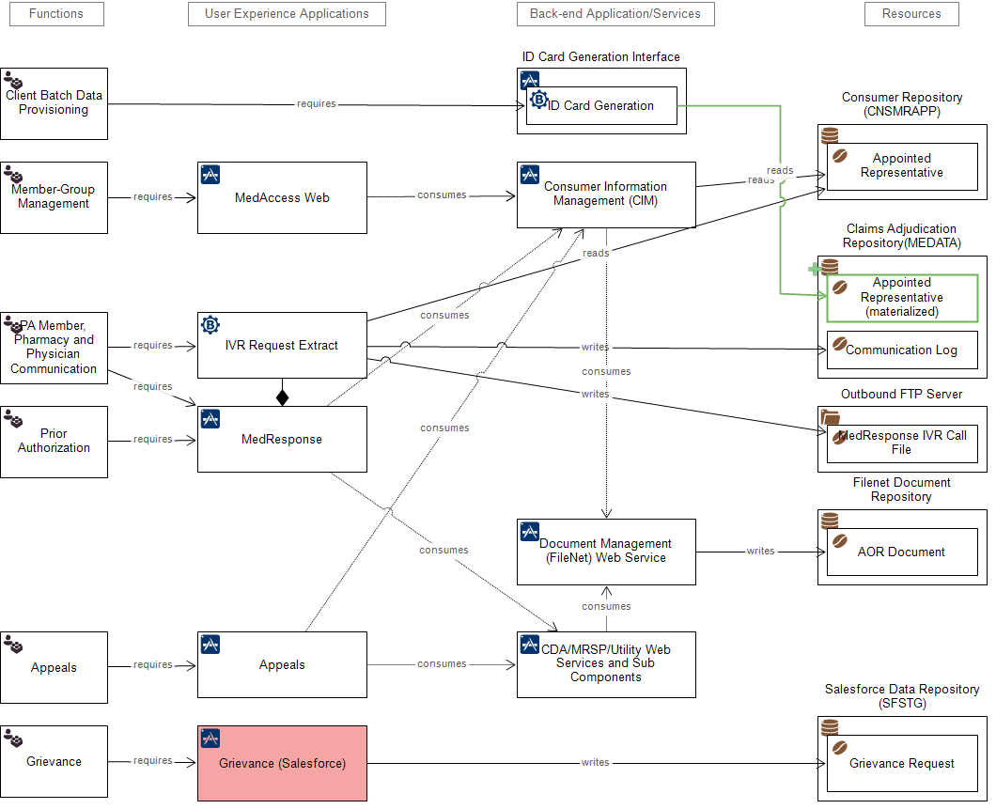
Target Architecture Landscape – AOR Consumers

Slide 16
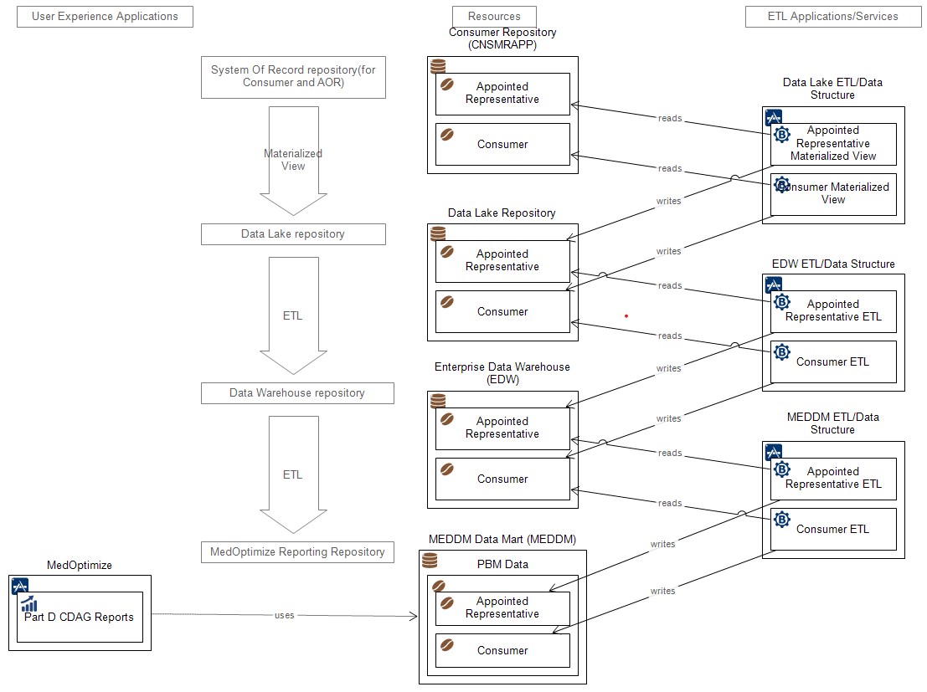
Target Architecture Landscape – AOR Reporting

Slide 17
Application Impacts (1 of 3)
Application Name | Service Name | Impact Description | Change Effort
Employee Portal | AOR Management UI (Employee Portal) | [1a] Create a new Manage AOR UI application available via the Employee Portal that supports the creation and update of AOR record(s) for a member. This new UI will need to use the Consumer Info Manager web service to create and view the AOR data. [1b] This new UI will also need to allow the user to upload an AOR Document from a file server and call the FileNet Document Management web service to store it in FileNet (as well as retrieve it). [Question: Should this UI support or not allow users to create/modify AOR records associated with authorization right = “CONSUMER_PORTAL_ACCESS”?] | Medium
Consumer Info Mgr WS | Establish AOR | Add operations to the Consumer Info Manager web service to create and manage AOR Info for a consumer. This will be used to manage the source-of-truth for the AOR Info which is stored in the Consumer Info repository. Operations will be needed to: [2a] support the AOR Management UI in the Employee Portal, and [2b] support loading an AOR Type 88 record into the database. | Large
 | View AOR | [3] Add capabilities to the Consumer Info Manager web service to view AOR Info and retrieve the associated AOR documents for a member. This will be used by consumers of AOR Info for purposes such as UI display, letter generation, etc. | Small
Document Mgmt (FileNet) Web Service | Document Mgmt WS | [4a] Configure FileNet to support a new document type for storage of AOR Documents. [4b] Create a new version of the FileNet Document web service to support the storage and retrieval of AOR Documents. | Small
MedAccess Web | Member Details UI | [5] Modify the existing main Member screen in MedAccess (web) to ensure that it continues to properly indicate when an active AOR exists for the member. This needs to use the Consumer Info Manager web service to access the AOR data in the Consumer Info repository. (Note: The existing screens directly access AOR data from the old data structures in the MEDM MEDATA repository.) | Small
 | View AOR Info UI | [6a] Modify the existing MedAccess (web) UI screens that support viewing AOR info for a member. MedAccess will need to use the Consumer Info Manager web service to access the AOR data. (Note: The existing screens directly access AOR data from the old data structures in the MEDM MEDATA repository.) [6b] In addition, MedAccess will need to support the retrieval of AOR Documents from FileNet via the Consumer Info Manager web service. | Medium
MedAccess Classic |  | [17] Remove access for most users to the old AOR screens for creating new AOR records. Note that the DMR team will continue to need to be able to create AOR records in the old AOR tables until the new Manual Claims Management application has been deployed which will utilize a new data repository to store the name and address of a third-party person to have the DMR check sent to. | X Small

Slide 18
Application Impacts (2 of 3)
Application Name | Service Name | Impact Description | Change Effort
MedResponse | AOR Management UI (MedResponse) | [7] Create new MedResponse UI screens to support creation and update of an AOR record(s) with authorization right = “PERSONAL_REPRESENTATIVE” for the member associated with the PA. [Note: The AOR Management UI for MedResponse will need to allow the user to upload an AOR Document from their desktop machine and call the CDA Communication web service to store it in FiIeNet (as well as retrieve it). Also, it will use the Consumer Info Manager web service to access the AOR data.] | Medium
 | MedResponse BPM UI | [8a] Modify the MedResponse screens to display info for any active AOR record for the member with authorization right = “PERSONAL_REPRESENTATIVE”. [8b] Create a new UI screen in MedResponse that enables the user to associate an AOR with the PA. [8c] Add the ability to "pend" the PA request while waiting for member to return a valid AOR Form and ensure the timer is reset once the AOR Form is returned. [8d] Modify the Letter Generation UI to ensure that the letter is sent to the Appointed Representative if the Member associated with the PA has an active AOR with authorization right = “PERSONAL_REPRESENTATIVE”. The “Member Letter” will be sent to the most-recently submitted AOR (if any). | Large
 | MedResponse IVR Extract | [9] Create a MedResponse IVR Call File to be sent to the IVR vendor for outgoing IVR calls regarding the status PA requests. If there are more than one active AOR/Appointed Representative record with authorization right = “PERSONAL_REPRESENTATIVE”, use the one that was created most recently. | X Small
CDA/MRSP/Utility Web Services and Sub-Components | CDA Communication WS | [10] Modify the CDA Communication WS to add the ability to store/retrieve AOR Documents in FileNet | X Small
Appeals | AOR Management UI (Appeals) | [11] Create new Appeals UI screens to support creation and update of an AOR record(s) with authorization right = “PERSONAL_REPRESENTATIVE” for the member associated with the Appeal. [Note: The AOR Management UI for Appeals will need to allow the user to upload an AOR Document from their desktop disk and call the Appeals web service (which will call the CDA Communication web service) to store the AOR Document in FIleNet (as well as retrieve it).] | Medium
 | Process Appeal Angular UI | [12a] Modify the Appeals screens to display info for any active AOR record for the member with authorization right = “PERSONAL_REPRESENTATIVE”. [12b] Create a new UI screen in the Appeals app that enables the user to associate an AOR with the Appeal. [12c] Enable the user to create/edit AOR info and retrieve/store AOR Document(s) for a member. [12d] Modify the Letter Generation UI to ensure that the letter is sent to the Appointed Representative if the Member associated with the Appeal has an active AOR with authorization right = “PERSONAL_REPRESENTATIVE”. The “Member Letter” will be sent to the most-recently submitted AOR (if any). | Medium
 | Appeals WS | Modify the Appeals WS to call the AOR Info Management "operation(s)" of the Consumer Info Manager WS. This connectivity will be needed to support the various AOR-related Appeals functions. | Small

Slide 19
Application Impacts (3 of 3)
Application Name | Service Name | Impact Description | Change Effort
Type 88 AOR File Load | AOR Data Load | [18] Create new Type 88 AOR File Load program hosted in Informatica. This program will perform all of the standard file handling activities, read each record of the type 88 file, call a new Type 88 operation of the CIM web service to load each record into the database, and write the status for each record to the log/error files. | Medium
ID Card Generation Interface | ID Card Generation | Modify the Member ID Card Generation application (cards.sqr) to use a new source of AOR data. [19a] Create a new materialized view in MEDM MEDATA for key AOR-related tables that will allow the application to join to all active AOR/Appointed Representatives for a member with authorization right = “PERSONAL_REPRESENTATIVE”. . [19b] Create a DB function that the cards.sqr script will call at the start of the script to trigger a refresh of the materialized view. [19c] Change the cards.sqr query to link to the new materialized AOR-related tables to get the AOR/Appointed Representative’s name and address to send the card to. If there are more than one active AOR/Appointed Representative records, use the one that was created most recently. | Medium
MedOptimize | Part D CDAG Reports | [6] Configure Cognos to make the new AOR-related data items available for selection in ad hoc MedOptimize reports. Ensure existing MedOptimize reports are not broken (or modify those reports). [Note: There are a number of PA and Appeals Reports that may depend on the date/time the member letter is sent out. Ensure these reports still work for cases where the member letter is sent to the Appointed Representative.] | X Small
Data Lake ETL | Appointed Representative ETL | [14] Create new AOR-related data structures in the Data Lake repository. Create ETL to populate AOR-related data structures in Data Lake from data in the Consumer Info repository. | Small
EDW ETL | Appointed Representative ETL | [15] Create new AOR-related data structures in the Data Warehouse (EDW) repository. Create ETL to populate AOR-related data structures in EDW from data in the Data Lake repository. | Small
MEDDM ETL | Appointed Representative ETL | [16] Create new AOR-related data structures in the MedOptimize data repository (MEDDM). Create ETL to populate AOR-related data structures in MEDDM from data in EDW. | Small

Slide 20
Appendix
Supporting material

Slide 21
Business Stakeholders
Name | Title | Concern
Andrea Allmon | VP, Enterprise Analytics | GER Sponsor
Nicole Anderson | BSA, Formulary Services | BRD Author
John Lopez | Manager, BI Reporting | Part D CDAG Reporting Universe
Tom Watson | Project Manager, Medicare | CMS Required Reporting
Pamela Montanile (Jandi Superales backup) | Program Manager, Medicaid Programs | Medicaid and Marketplace
Richard Arguelles | Principle, PA Administration | Prior Authorization
Dawn Martin / Karen Redd Guinto | Manager, Appeals and Grievances / Supervisor, Appeals and Grievances | Appeals and Grievances, Legacy intake of AOR requests and entry in MedAccess
Quan Nguyen | Manager, QA and Client Services | PA Audit – Medicare Part D
Jason Elias | Supervisor Prior Authorization | PA Operations– Medicare Part D
Kathy Brewer | Director, Customer Contact Services | Contact Center, Direct Member Reimbursement
Cate Osterrieder | Lead Client Services | Client Services
Carol Germain | Manager, Business Solutions | MedAccess, Consumer Portal, File Load/Extract
Jennifer Johnson | Director, Regulatory Compliance | Legal Issues

